Slide 1
Title goes here
Subtitle to go here

Slide 2
Title goes here
Subtitle to go here
9.07
ROLLOUT

Slide 3
Divider page title goes here

Slide 4
Divider page title goes here

Slide 5
Divider page title goes here

Slide 6

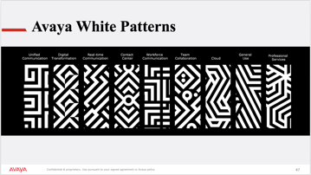
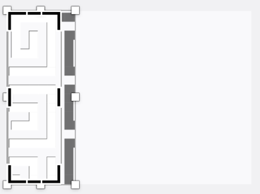
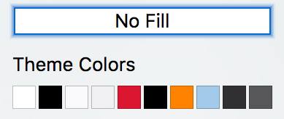

Boxes with pattern detail
To add lighter boxes behind body copy:
Choose and draw shape
Shape Fill > choose lighter colors in color palette
Choose patterns from Avaya White Pattern page, position over shape
Crop as desired.
Step 1
Step 2
Step 3
Step 4

Slide 7

Headline goes here
Body copy goes here
Body copy goes here
Body copy goes here
Body copy goes here
(HOW TO USE THIS SLIDE)
- If you choose to use a full-bleed image, use this box with the pattern
You’ll notice the pattern aligns with the red bar in the headline
Full-bleed images will vary, be sure to modify the box so that it never impedes with the person(s) in the image
If you need more photos, please contact Brian Haumersen

Slide 8

Headline goes here
Body copy goes here
Body copy goes here
Body copy goes here
Body copy goes here
(HOW TO USE THIS SLIDE)
- If you choose to use a full-bleed image, use this box with the pattern
You’ll notice the pattern aligns with the red bar in the headline
Full-bleed images will vary, be sure to modify the box so that it never impedes with the person(s) in the image
If you need more photos, please contact Brian Haumersen

Slide 9
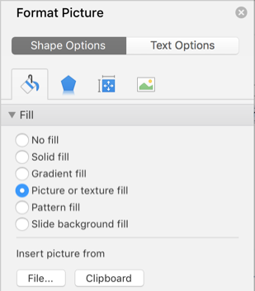
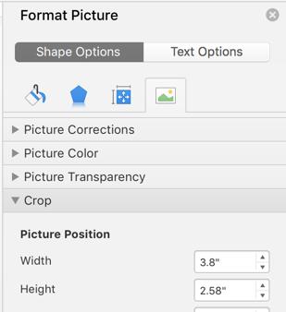
Shape Forms
To add patterns to shape forms:
Click twice on shape to bring up format picture window
Fill > Picture or texture fill
Insert picture from > file…(if you want a specific pattern/picture)
To change proportions of pattern/picture, choose tab all the way to the
crop >picture position > (adjust height and width until proportion is correct)
Choose and draw shape
Step 1
Step 2
Step 3

Slide 10



Examples of shape forms

Slide 11
Headline goes here
Body copy goes here
Body copy goes here
Body copy goes here
(HOW TO USE THIS SLIDE)
This is a basic content slide
There are no brand graphics applied.
This slide would be used when there is either a large amount of copy or heavy graphics that would compete with any brand graphics.

Slide 12
Headline goes here
Body copy goes here
Body copy goes here
Body copy goes here
(HOW TO USE THIS SLIDE)
This is a basic content slide
This is what we call the ‘Abstracted A.’ It is always cropped on at least two sides.
This is set up as a Master Slide and shouldn’t be modified.
There are a few of these with different patterns that you can choose from.

Slide 13
Headline goes here
Body copy goes here
Body copy goes here
Body copy goes here
Body copy goes here
(HOW TO USE THIS SLIDE)
This is a basic content slide
This is set up as a Master Slide and shouldn’t be modified.
There are a few of these with different patterns that you can choose from.

Slide 14
Headline goes here
Body copy goes here
Body copy goes here
Body copy goes here
Body copy goes here
(HOW TO USE THIS SLIDE)
This is a basic content slide
This is set up as a Master Slide and shouldn’t be modified.
There are a few of these with different patterns that you can choose from.

Slide 15
Headline goes here
Body copy goes here
Body copy goes here
Body copy goes here
Body copy goes here
(HOW TO USE THIS SLIDE)
This is a basic content slide
This is set up as a Master Slide and shouldn’t be modified.
There are a few of these with different patterns that you can choose from.

Slide 16

Headline goes here
Body copy goes here
Body copy goes here
Body copy goes here
(HOW TO USE THIS SLIDE)
This slide can be used if you have a graphic that supports the content.
The box can change in size, but the the graphic panel should be about 20% of the photo width.
The blue bar on the bottom is used to bring in another visual element that represents the brand.

Slide 17
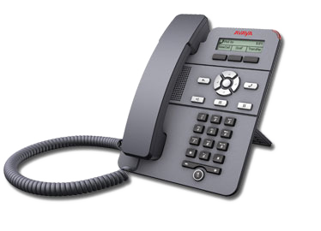
Product images
Guidelines to highlighting products
Do not cover product with pattern or tints
Always put the product on the top layer
Don’t be afraid to use a brand element like the ‘Abstracted A’ behind the product. It will tie the product to the Avaya brand.
Use a headline with supporting copy to describe the product.
Avaya J129 IP Phone

Slide 18

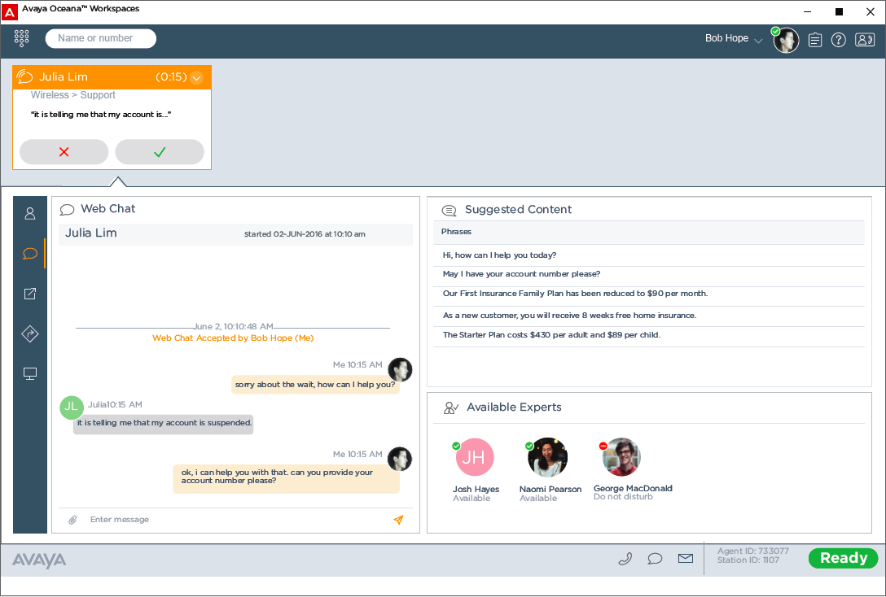
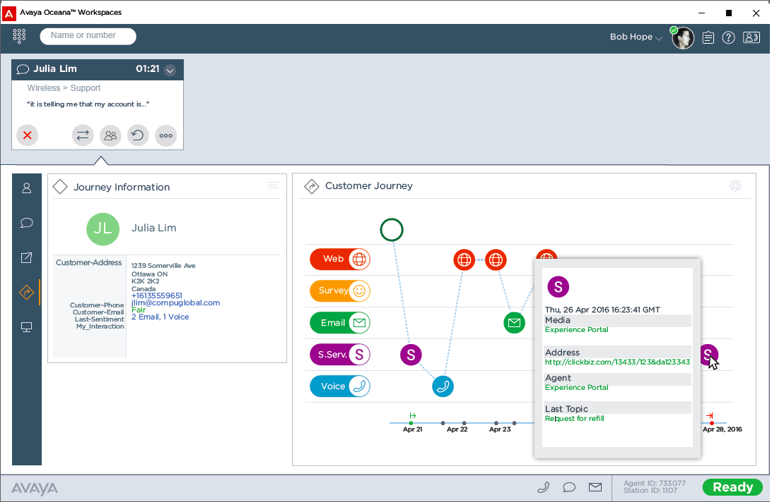
Screen shots
With Avaya, copy goes here, copy goes here
(HOW TO USE THIS SLIDE)
Our conversation starter is a great way to connect to screen grabs
Use lines that are our brand colors to connect the screen shots to the conversation.

Slide 19

Large quote goes here. - Author name
(HOW TO USE THIS SLIDE)
This slide can be used if you have a graphic that supports the quote.
The ‘Abstracted A.’ is always cropped on at least two sides.

Slide 20

Body copy to go here…Body copy to go here…
Body copy to go here…Body copy to go here…
Body copy to go here…
(HOW TO USE THIS SLIDE)
This is an example of how you can add a logo and photo that supports the content.

Slide 21




Headline to go here
Headline
Headline
Headline
Headline
Supporting copy to go here
Supporting copy to go here
Supporting copy to go here
Supporting copy to go here
(HOW TO USE THIS SLIDE)
This slide can be used to show comparisons, highlight benefits or separate features of a product.
Notes:
Format Picture > Picture Color > Recolor Preset > Blue setting >

Slide 22
Color overlay
To add color overlay to photos:
Step 1
Step 2
Format Picture > Picture Color > Recolor Preset > Grey setting
Insert Shape > Rectangle > Set size to 2.25x2.25 > Choose color Light Blue, Accent 4 > Set Fill Transparency to 65% > Line up photo and box > Group
Notes:
Format Picture > Picture Color > Recolor Preset > Grey setting
Insert Shape > Rectangle > Set size to 2.25x2.25 > Choose color Light Blue, Accent 4 > Set Fill Transparency to 65% > Line up photo and box > Group

Slide 23




Avaya cards
HEADLINE
HEADLINE
HEADLINE
HEADLINE
Supporting Copy to go here
Supporting Copy to go here
Supporting Copy to go here
Supporting Copy to go here
(HOW TO USE THIS SLIDE)
This slide can be used to show comparisons, highlight benefits or separate features of a product.

Slide 24
Headline goes here
Subhead goes here
Subhead goes here
Body copy goes here
Body copy goes here
Body copy goes here
Body copy goes here
(HOW TO USE THIS SLIDE)
This is a basic two column content slide
This is set up as a Master Slide and shouldn’t be modified.

Slide 25
Headline to go here
(HOW TO USE THIS SLIDE)
This is an example of a line chart if created in PowerPoint.
The colors are already in the color palette and will populate automatically.
Please replace any black lines with the charcoal gray.

Slide 26
Headline to go here
(HOW TO USE THIS SLIDE)
This is an example of a vertical bar chart if created in PowerPoint.
The colors are already in the color palette and will populate automatically.
Please replace any black lines with the charcoal gray.

Slide 27
Headline to go here
(HOW TO USE THIS SLIDE)
This is an example of a stacked area chart if created in PowerPoint.
The colors are already in the color palette and will populate automatically.
Please replace any black lines with the charcoal gray.

Slide 28
Headline to go here
(HOW TO USE THIS SLIDE)
This is an example of a pie chart if created in PowerPoint.
The colors are already in the color palette and will populate automatically.
Please replace any black lines with the charcoal gray.
Body copy to go here
Body copy to go here
Body copy to go here
Body copy to go here
Body copy to go here

Slide 29
Headline to go here
(HOW TO USE THIS SLIDE)
This is an example of a hortizontal bar chart if created in PowerPoint.
The colors are already in the color palette and will populate automatically.
Please replace any black lines with the charcoal gray.
Body copy to go here
Body copy to go here
Body copy to go here

Slide 30
Headline to go here
(HOW TO USE THIS SLIDE)
This is an example of a table that can be created in PowerPoint.
Please use colors as shown to emphasize different sections of the table.
The colors are all available in the color palette.
Headline to go here
Subhead | Subhead |  | Subhead |  | Subhead
Body copy goes here…Body copy goes here...
Body copy goes here…Body copy ggoes o here...
Body copy goes here |  | Body copy goes here |  | Body copy goes here
Body copy goes here…Body copy goes here...

Slide 31
Headline to go here
(HOW TO USE THIS SLIDE)
This is an example of an Illustration used in PowerPoint..
Please use the colors in the color palette as shown.
Copy goes here
Copy goes here
Copy goes here
Copy goes here
Copy goes here

Slide 32
“Ecaborit lab ipitis dipsum culpa natium aut quaepere nis etur?Aximet adia velitatet evellectet, suntem quid maximus.”
(HOW TO USE THIS SLIDE)
This page is meant to contain a large quote and is useful in creating visual interest especially when it’s preceded by several content-heavy slides.
The graphic is one of our brand assets that we call a ‘conversation starter’.
If you need other photos for the conversation starter, please contact Brian Haumersen

Slide 33
“Aximet adia velitatet et, suntem quid maximus.”?
(HOW TO USE THIS SLIDE)
This page is meant to contain a large quote and is useful in creating visual interest especially when it’s preceded by several content-heavy slides.
The graphic is one of our brand assets that we call a ‘conversation starter’.
If you need other photos for the conversation starter, please contact Brian Haumersen

Slide 34
“Ad undis minum volorempor sintis alitatur fugiam ium doluptaqui nobis doluptatae earibusapit natur sim exerum ?” - Author name
(HOW TO USE THIS SLIDE)
The full color bleed is a good way to visually break up the deck.

Slide 35
“Otatet eos dolore ipsum es des alitatur sim exerum remporum hit es des alitatur sim exerum vollorro sit tenecae ptatiur?” - Author name
(HOW TO USE THIS SLIDE)
The full color bleed is a good way to visually break up the deck.

Slide 36






Avaya White Patterns
Unified Communication
Digital Transformation
Real-time Communication
Contact Center
Workforce Communication
Team Collaboration
General Use
Professional Services
Cloud
(HOW TO USE THIS SLIDE)
This page contains all the Avaya patterns.
You can access more of the pattern by selecting the pattern, click right to crop, and adjust the size and crop as you see fit.

Slide 37
Thank you.

